Slide 1


NYC Taxi Profitability and Activity Analysis

Slide 2




Journey of Contents
Overview
Data Understanding, Cleaning, and Enriching
Conclusion &
Recommendation
Statistical & Data Analysis

Slide 3
Overview

Slide 4




Overview
Dataset
General Problem
New York City Taxi and Limousine Commission (TLC) dataset consists of detailed transactions of TLC from 2 different payment gateway providers.
The dataset doesn’t differentiate between Medallion Cab or Boro Cab. It has variable that differentiate type of the taxi ride whether they are street-hail or ordered by dispatch.
Albeit being the icon of the city, NYC TLC is still losing money from some unprofitable trips. One of the ways to handle this, is NYC TLC considered opening an ad space that targeted to the most audience within the busiest pick-up zone in the busiest pick-up time.
Up To 2600+
1 Jan - 31 Jan 2023
Goals
Daily customer
Dataset Range
To obtain the busiest pick-up spot and the most profitable spot, and recommend action on which pick-up spot that generates the least profit.
More than 13000x
More than 12K Mi
Monthly pick-up
Trip travelled

Slide 5
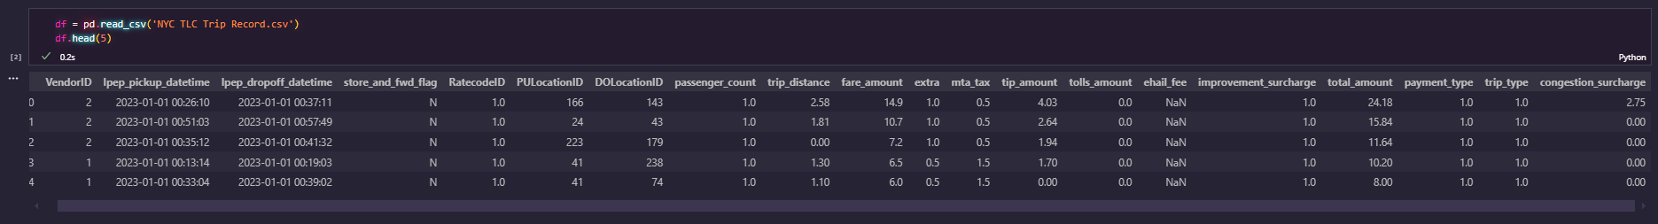
Data Understanding
VendorID: ID of vendors
Lpep Pickup Datetime: Datetime where a passenger is picked up
Lpep Dropoff Datetime: Datetime where a passenger is dropped off
Store and Forward Flag: To Flag whether the trip record was held in the vehicle memory before sending it to the vendor. (Yes or No)
RateCodeID: Final Rate Code, in effect at the end of the trip (1=std; 2=JFK; 3=Newark; 4=Nassau|Westchester; 5=Nego Fare; 6=Group Fare)
Pickup LocationID: ID of location where a passenger is picked up
Dropoff LocationID : ID of location where a passenger is dropped off
Passenger Count: Number of passenger in a trip
Trip Distance: Distance of a trip
Fare Amount: Amount of fare
Extra: Surcharges 0.50$ rush hour or 1$ overnight charges
MTA Tax: Automatically truggered based on the metered rate in use.
Tip Amount: Amount of tip
Tolls Amount: Amount of tolls paid in a trip
Improvement Surcharge: $0.30 improvement surcharge assessed on hailed trips at the flag drop. The improvement surcharge began being levied in 2015.
Total Amount: Amount charged to passengers. Cash Tips excluded
Payment Type: type of payment (1= Credit Card; 2=cash; 3=No Charge; 4=Dispute; 5 = Unknown; 6=Voided Trip)
Trip Type: type of taxi trip (1=Street-hail; 2=dispatch)
Congestion surcharge: Amount added to the payment due to congestion

Slide 6
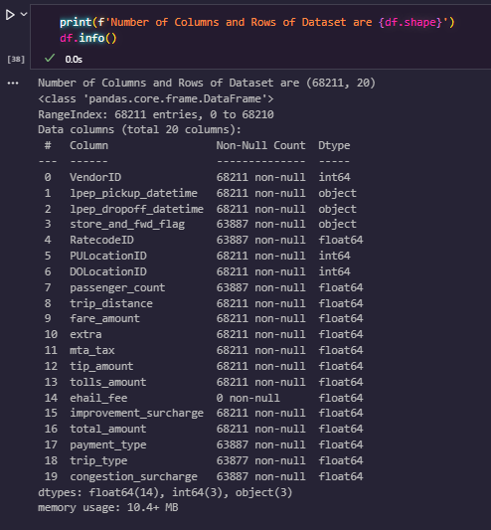
Data Understanding
NYC TLC dataset contains of 68210 rows of data and 20 columns of data
info() function shows that ‘ehail_fee’ columns has 0 non-null count, which means all of its content are NULL value

Slide 7
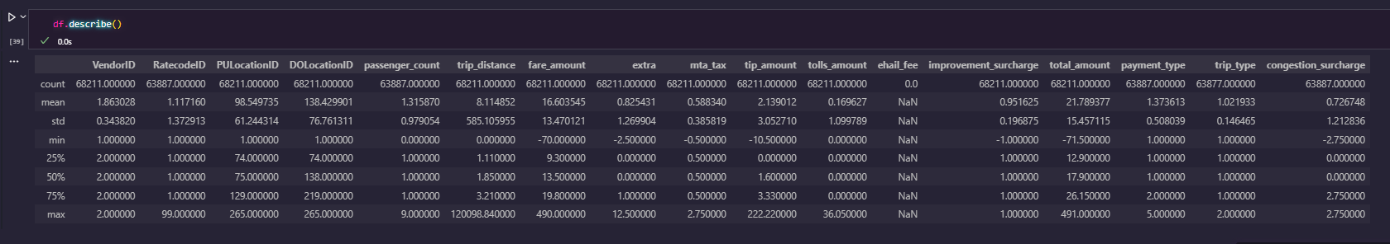
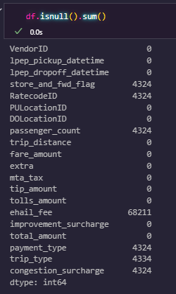
Data Understanding
describe() function also shows that ‘ehail_fee’ columns has NaN value, and the count is 0.0, that means the column has only NULL value. Same result with the function isnull(), where we sum the result of NULL values on each columns.

Slide 8
Data Cleaning
Now that we know about the NULL values on each column. We shall treat them by either dropping the off of our dataset or filling them with proper fillings.

Slide 9
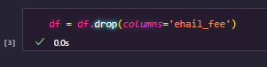
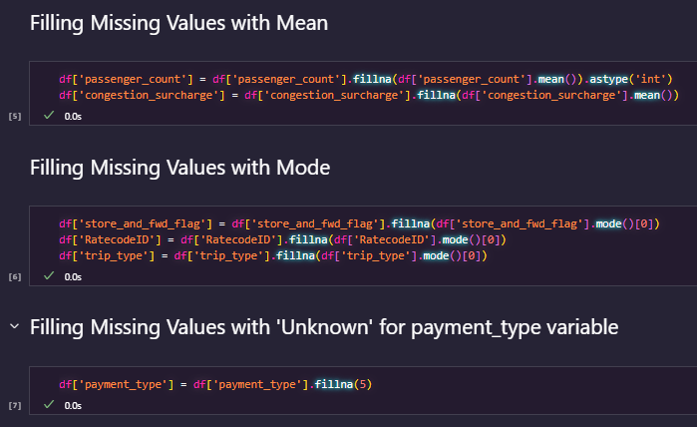
Data Cleaning
Dropping the ‘ehail_fee’column
Filling Missing Values in the Dataset
Payment Type:
type of payment (1= Credit Card; 2=cash; 3=No Charge; 4=Dispute; 5 = Unknown; 6=Voided Trip)

Slide 10
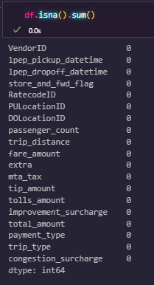
Data Cleaning
Before Data Cleaning
After Data Cleaning

Slide 11
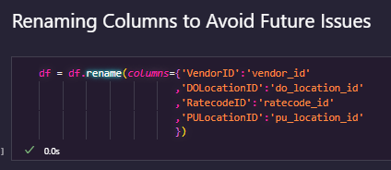
Data Cleaning
Standardizing columns

Slide 12
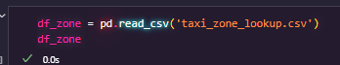
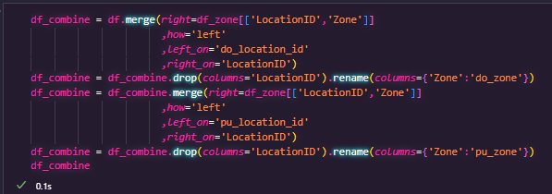
Data Enriching
Obtaining taxi_zone_lookup dataset
Combining on LocationID

Slide 13
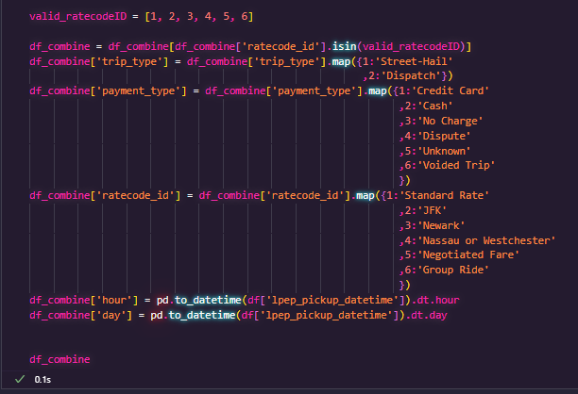
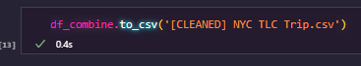
Data Enriching
Filtering the ratecode column and mapping the numerical value to be categorical as seen on dictionary
Producing the data to be used in Tableau

Slide 14
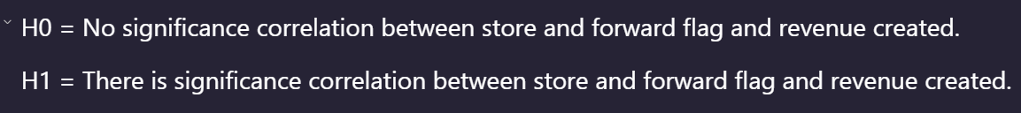
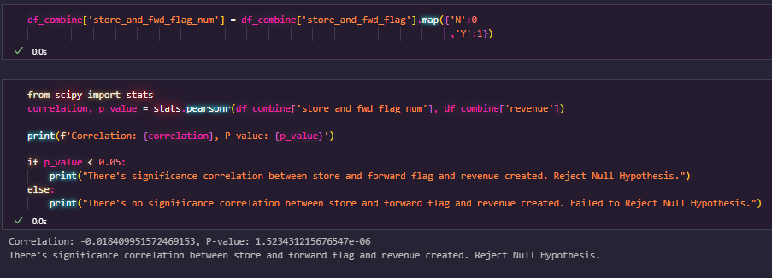
Statistical Analysis
Inferential Analysis
Does Store and Forward Flag affects the revenue?

Slide 15
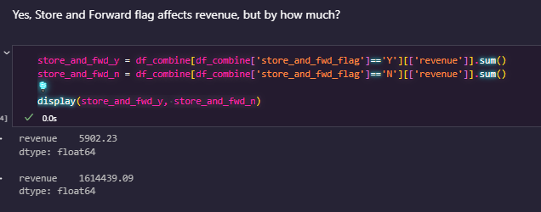
Statistical Analysis
Inferential Analysis
It turns out, Taxis without store and forward flag generates more revenue compared to the one who are equipped with

Slide 16
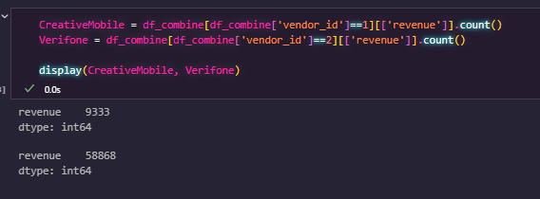
Statistical Analysis
Descriptive Analysis
Creative Mobile vs Verifone, which one generates transaction?
Verifone payment gateway generates more number of transaction compared to Creative Mobile

Slide 17
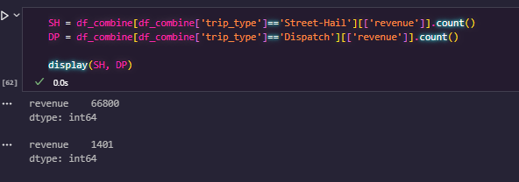
Statistical Analysis
Descriptive Analysis
Street-Hail vs Dispatch, which one generates transaction?
Street-Hail method generates more number of transaction compared to Dispatch method

Slide 18
Statistical Analysis Conclusion
Street Hail generates more transaction than Dispatch, this could be a sign that more customer are prefer street hailing directly than go through the phone call to the dispatch
Verifone generates more transaction than Creative Mobile, this could be a sign that Verifone is much more applied in the Taxi than Creative Mobile. Or it could be that Customers prefer more to use Verifone than Creative Mobile

Slide 19
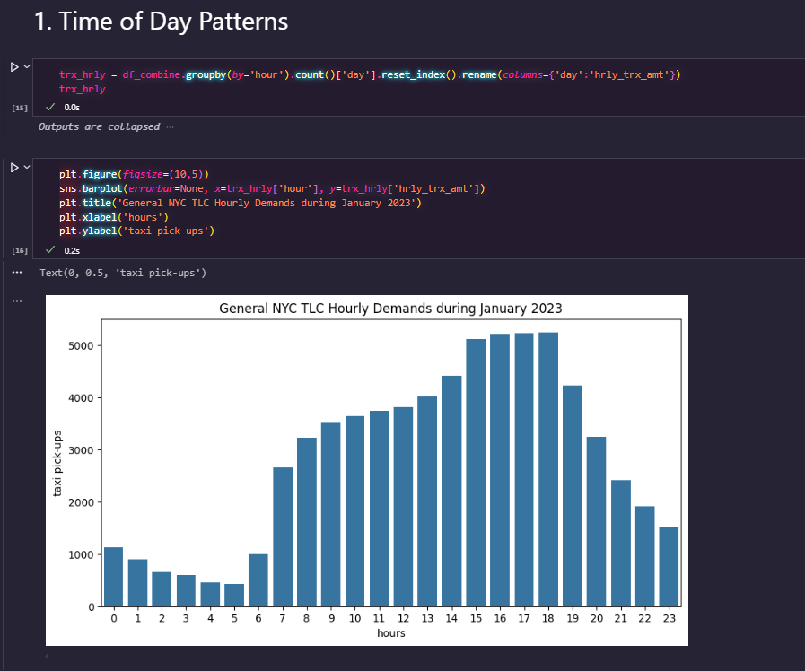
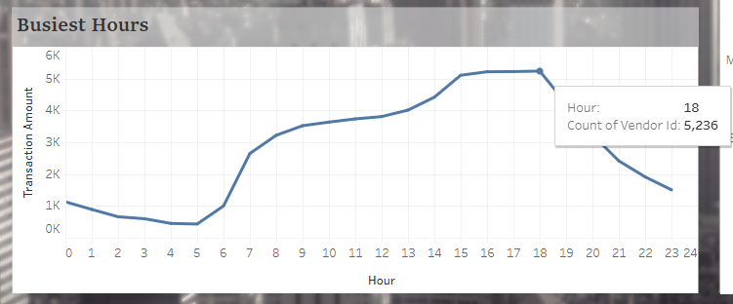
Data Analysis
First, we detect hourly demands of taxi in the whole month. Turns out at taxi demand is on the rise from 3 PM to 6 PM.
This symbolises that most taxi customers are office workers that travels home during those hours.

Slide 20
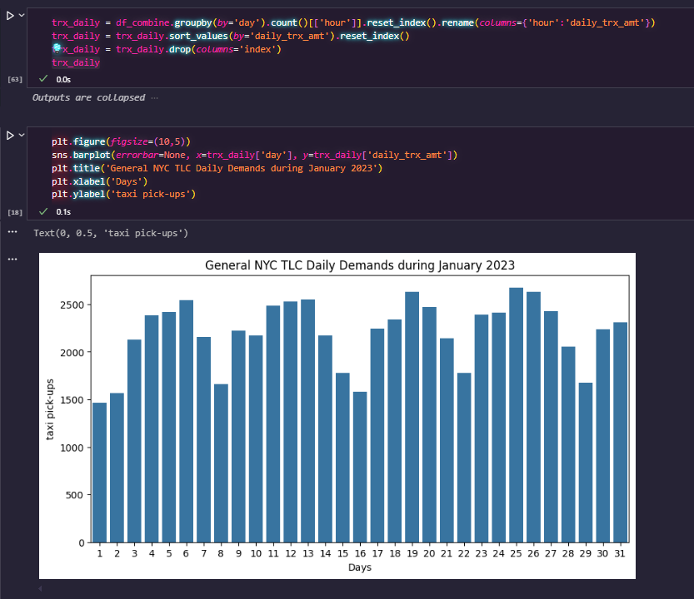
Data Analysis
Daily data during that month shows that most taxi’s demand are on the higher ground on:
4th, 5th, 6th, 11th, 12th, 13th, 18th, 19th, 20th, 25th and 26th of January.

Slide 21
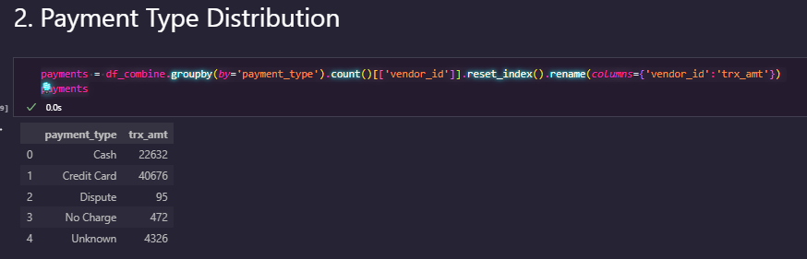
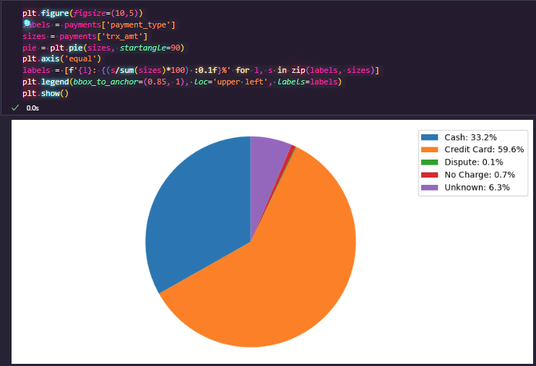
Data Analysis
Pie graph shows that 59% of the customers are using credit card, followed by cash on 33.2%
This signifies that most of the customer is the people who uses credit card.

Slide 22
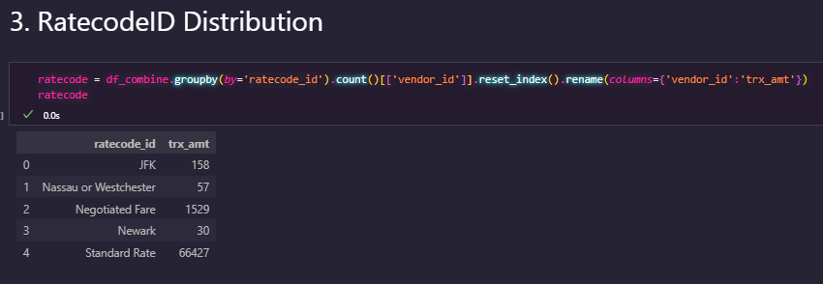
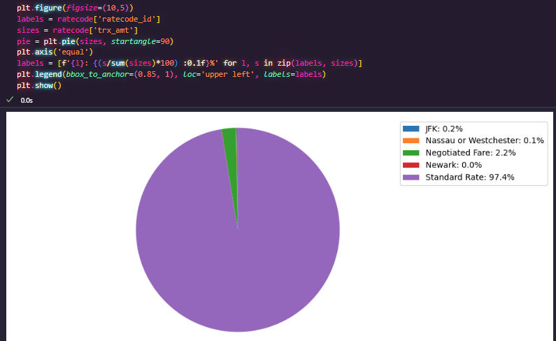
Data Analysis
Pie graph shows that MOST of the customer prefers using Standard Rate. This is related to the Street-Hail vs Dispatch, since most of the customers prefer Street-Hail, therefore Standard Rate is more preferred than Negotiated.

Slide 23
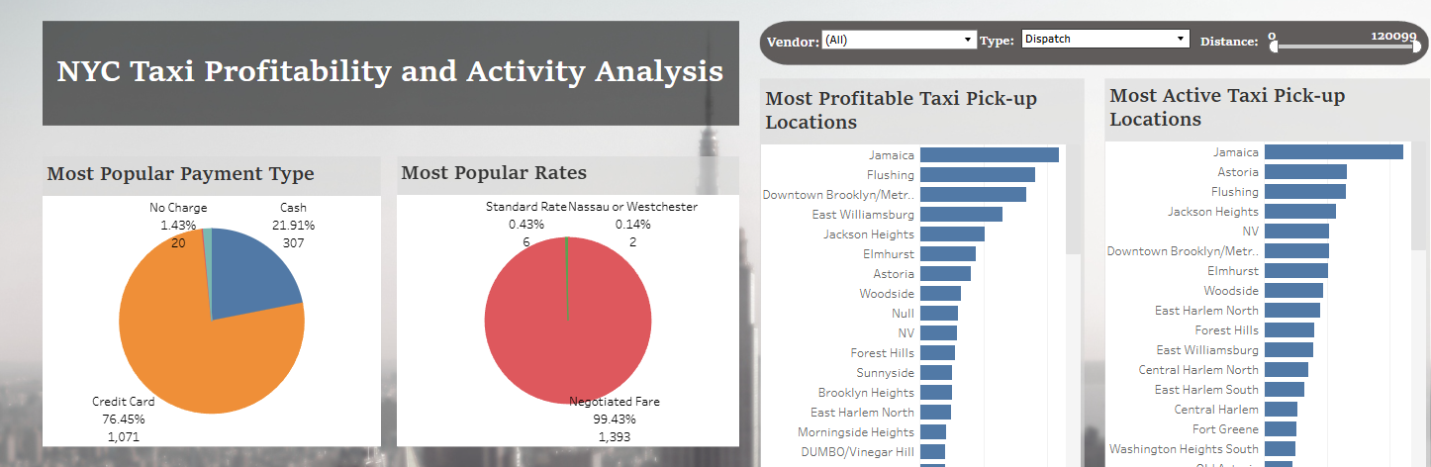
Data Analysis
In Dispatch, almost every customer prefer to go with negotiated fare. We can see on the tableau dashboard that it reaches almost 100% of the customer that prefers negotiated fare

Slide 24
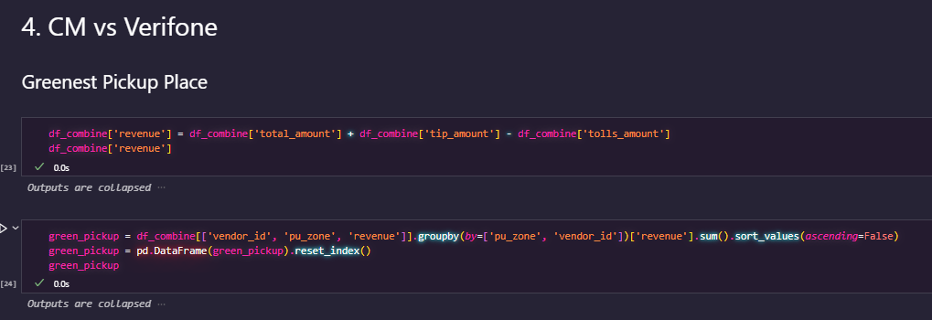
Data Analysis
Greenest in here refers to Pickup zone that generates the most revenue.

Slide 25
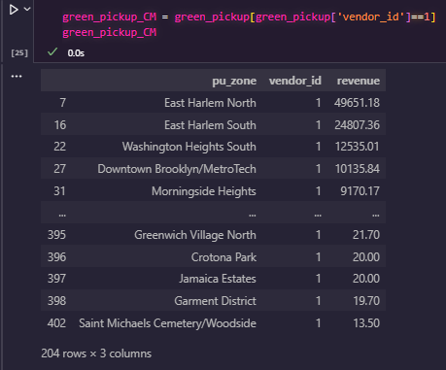
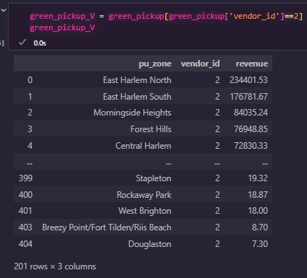
Data Analysis
We can see above that East Harlem generates the most revenue through the payment gateway of CreativeMobile
We can see above that East Harlem too generates the most revenue through the payment gateway of Verifone

Slide 26
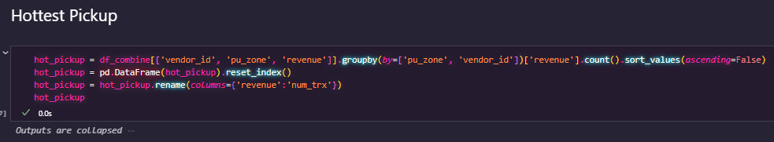
Data Analysis
Hottest in here refers to Pickup zone that generates the most number of transaction.

Slide 27
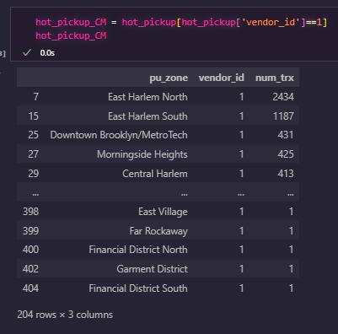
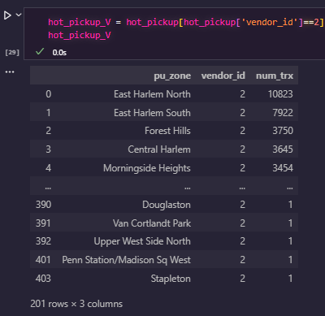
Data Analysis
We can see above that East Harlem generates the most num of trx through the payment gateway of CreativeMobile
We can see above that East Harlem too generates the most num of trx through the payment gateway of Verifone

Slide 28
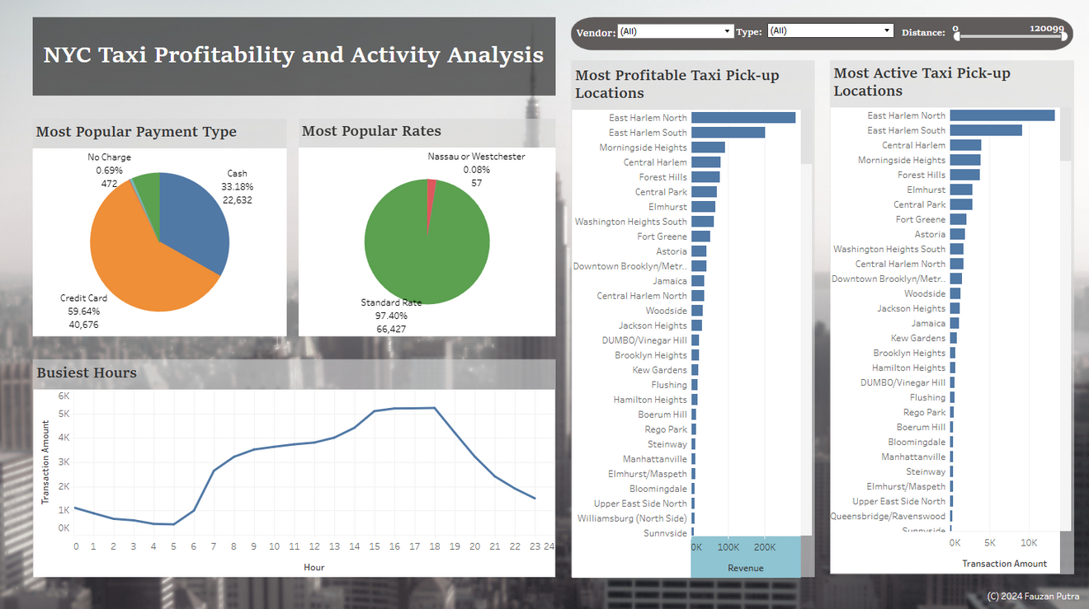
Tableau Dashboard
For better analysis visualisation, check out our Tableau dashboard, through the link below
https://public.tableau.com/app/profile/fauzan.harlyanto.putra/viz/NYCTaxiProfitabilityandActivityAnalysis/Dashboard1?publish=yes

Slide 29
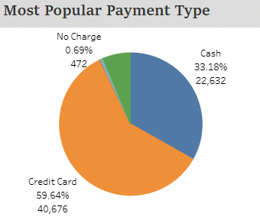
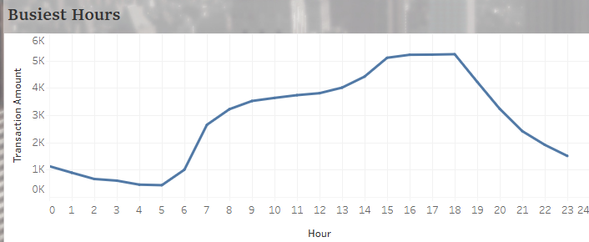
Conclusion
Descriptive Statistic:
Street Hail generates more transaction than Dispatch, this could be a sign that more customer are prefer street hailing directly than go through the phone call to the dispatch.
Verifone generates more transaction than Creative Mobile, this could be a sign that Verifone is much more applied in the Taxi than Creative Mobile. Or it could be that Customers prefer more to use Verifone than Creative Mobile.
Inference Statistic:
With P-Value = 1.52 * 10^-6 we can conclude that there is significance correlation between the ‘store and forward flag’ variable to ‘revenue’ variable
Visualisation:

Slide 30
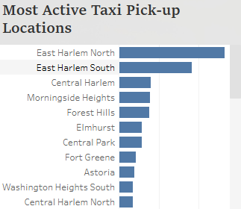
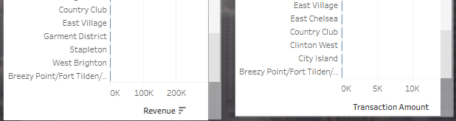
Recommendation
Our Goal:
To obtain the busiest pick-up spot and the most profitable spot, and recommend action on which pick-up spot that generates the least profit.
Busiest Pick Up Spot
Ad Spot:
Least Demand pickup Spot
East Harlem North and South being the top 2 most active pickup spot. We recommend this spot for NYC TLC to build a advertisement spot for passive revenue.
Promotion:
Having Breezy Point as the least profitable spot as well as the least pick-up demand, is an opportunity to plan a promotion, or targeted marketing campaign in the area. Dynamic Pricing might be good to implement as well.

Slide 31
Thank You

